Slide 1


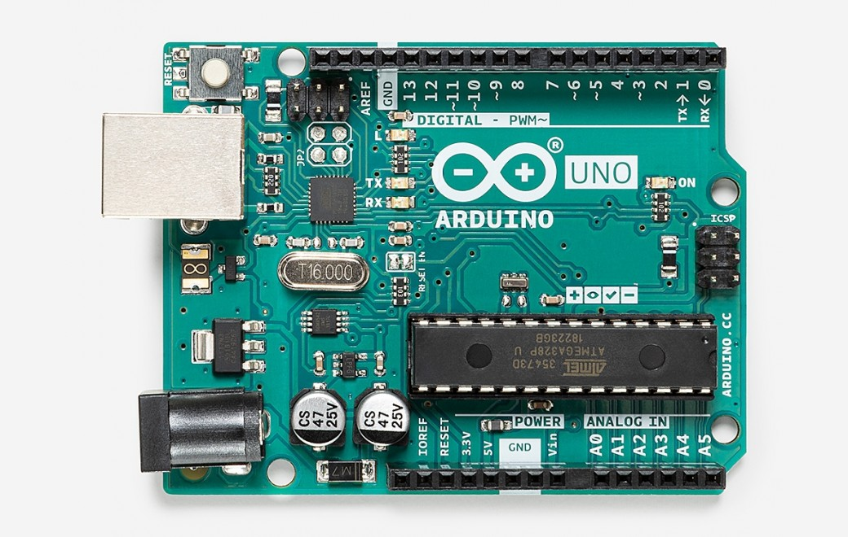
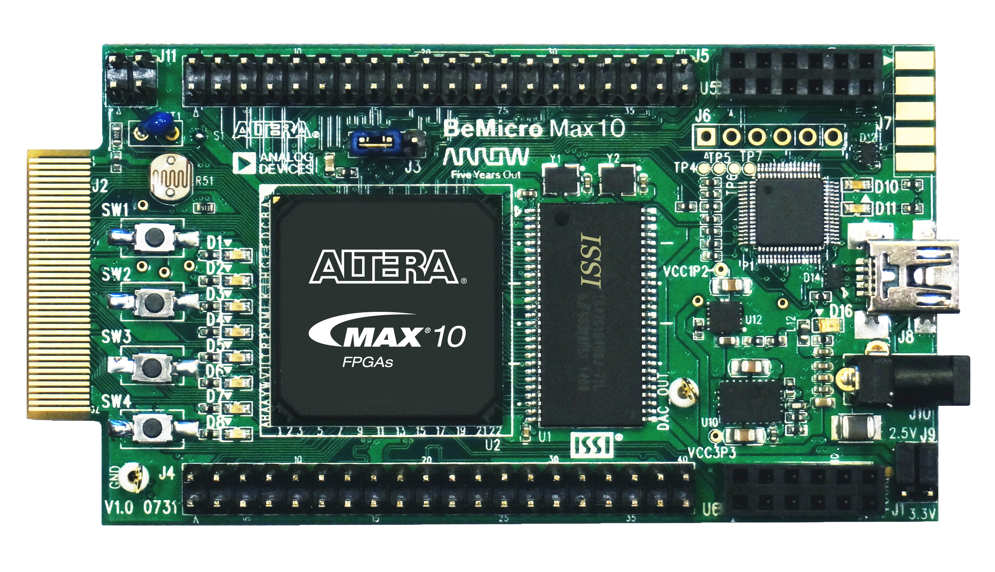
Monthly Mini Hacks From Arduino to FPGA: Synthesizing hardware from code!
July 31st, 2020 Justin Silver

Slide 2
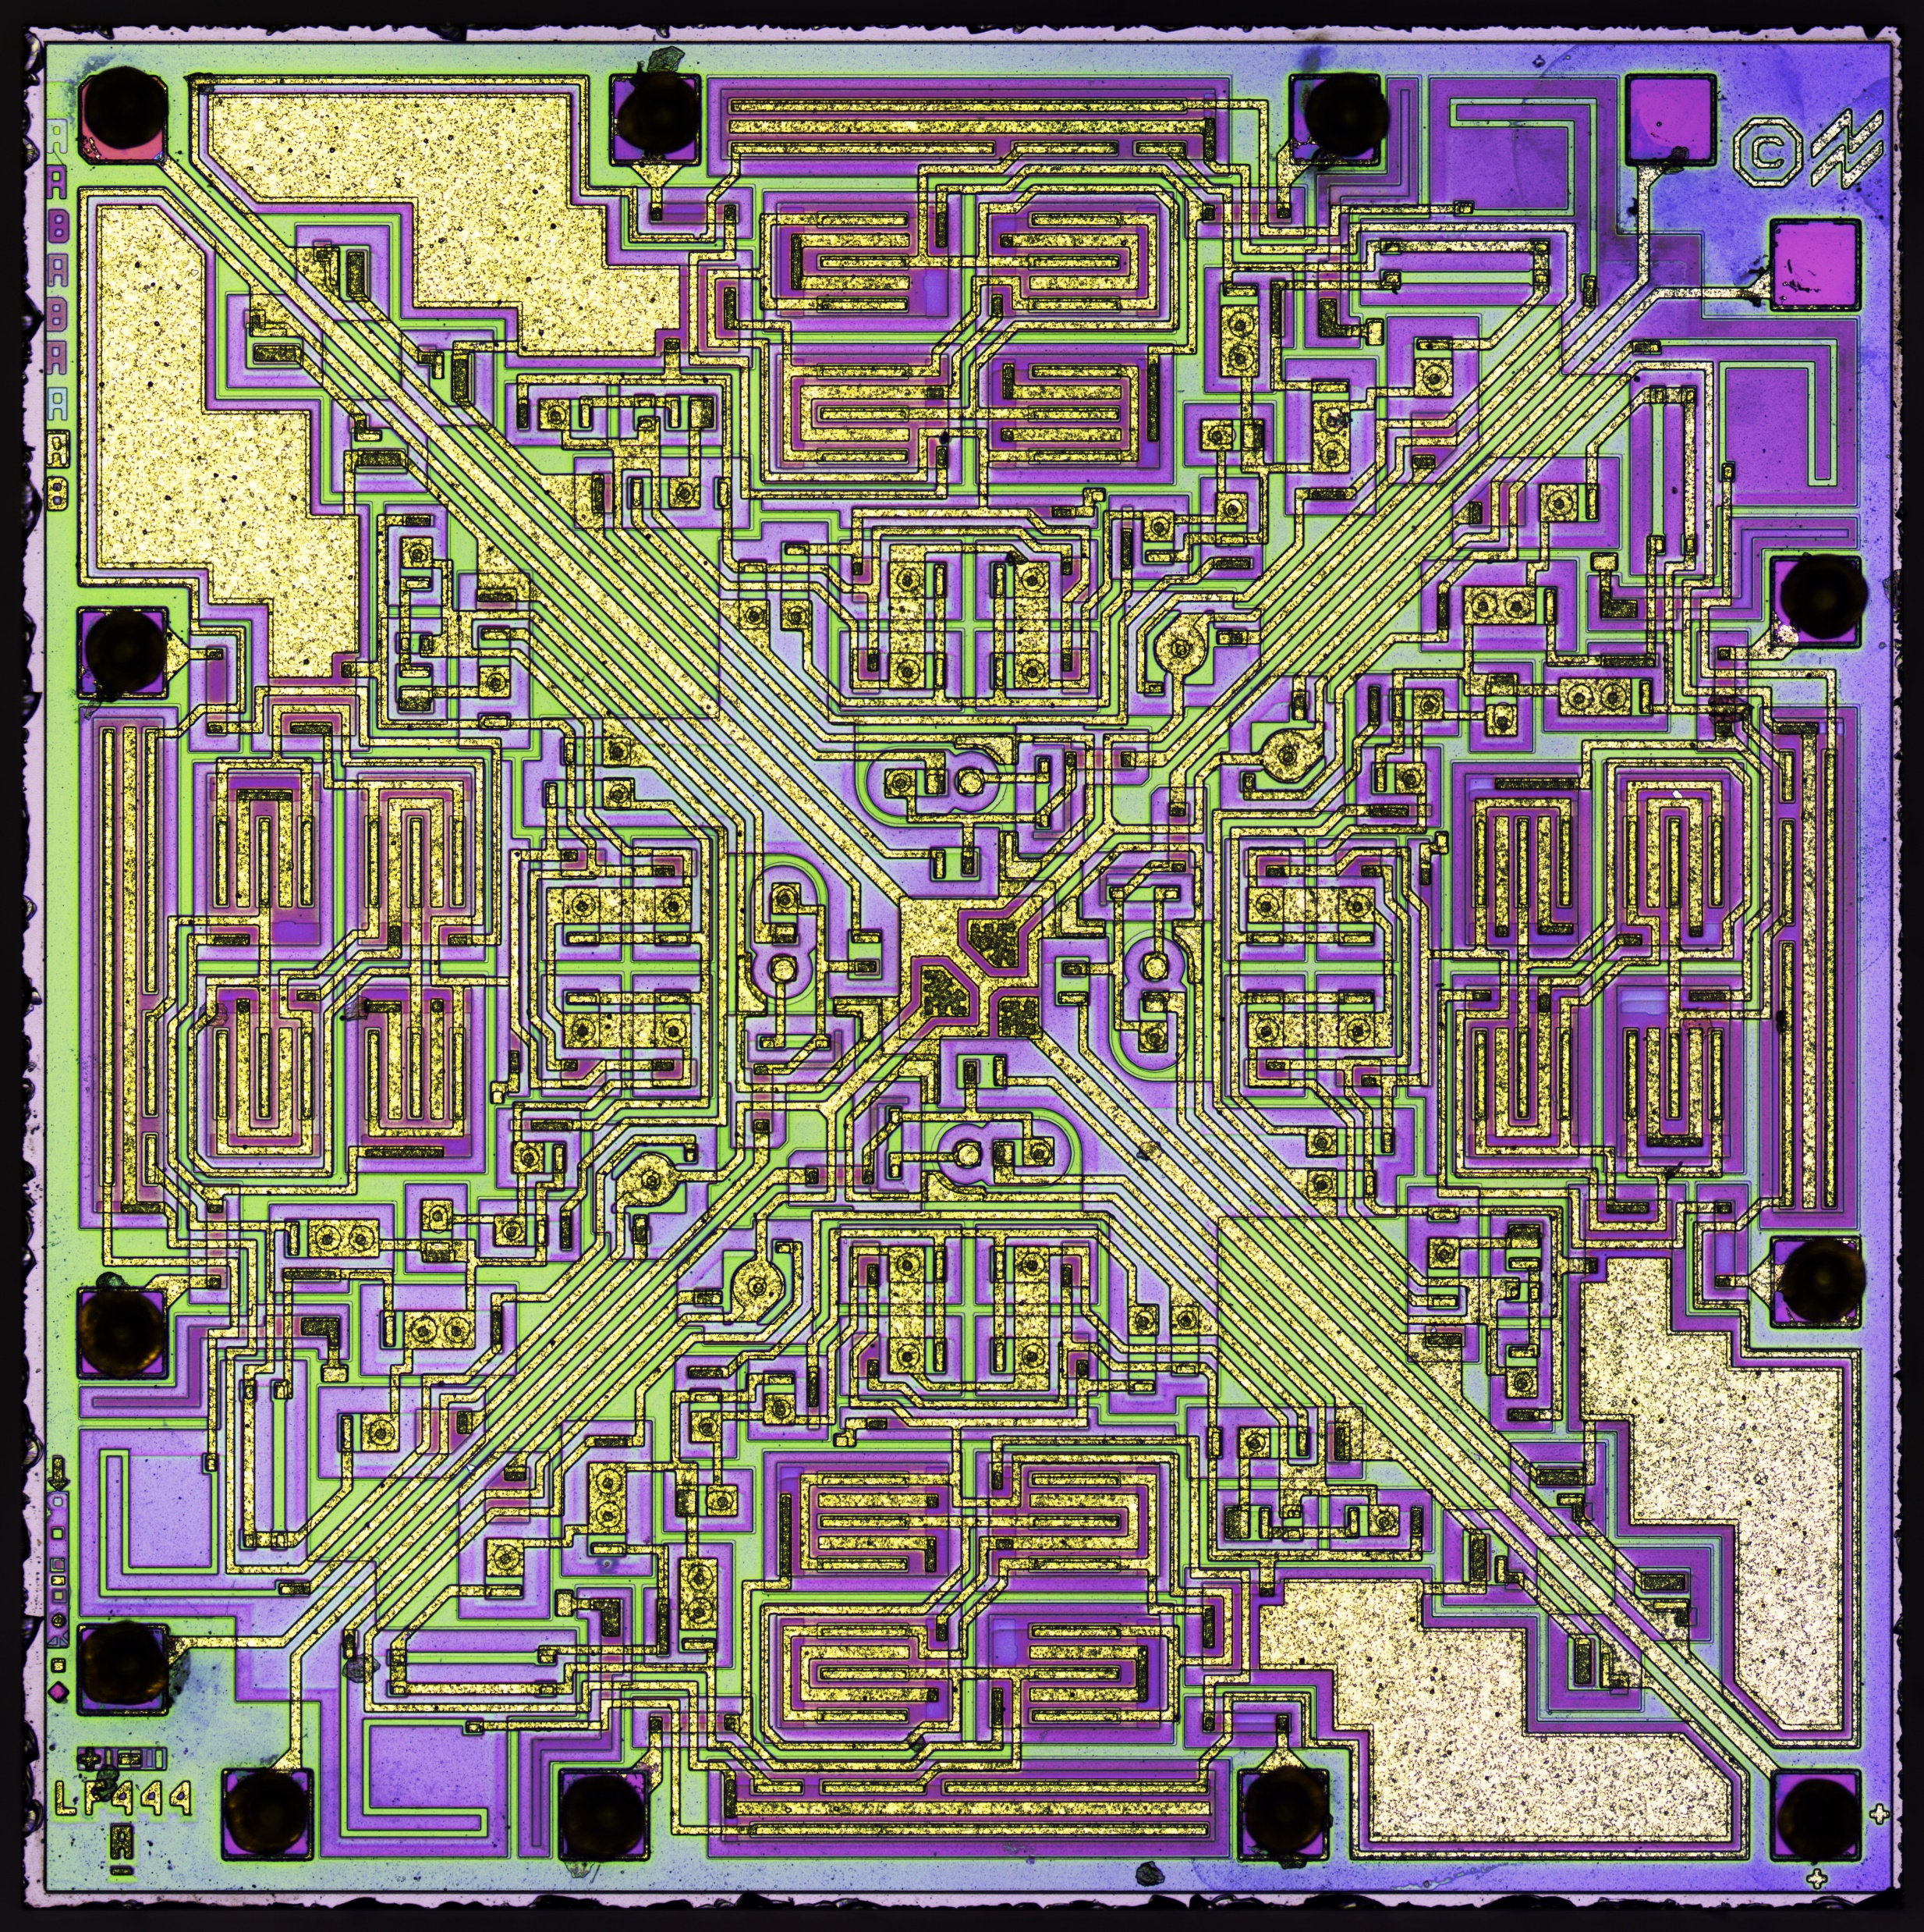
Plan
Presenter introduction
Listener introduction
Topic presentation
Arduino introduction
Coding – Arduino
Digital logic principles
FPGA and VHDL introduction
Coding – FPGA
Improvements
Annex/useful links
Die photo of LF444 – quad JFET op-amp (credit: zeptobars.com)

Slide 3
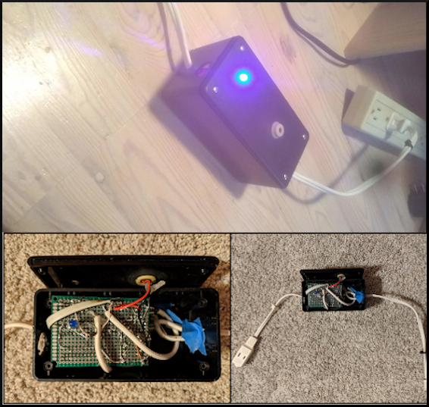
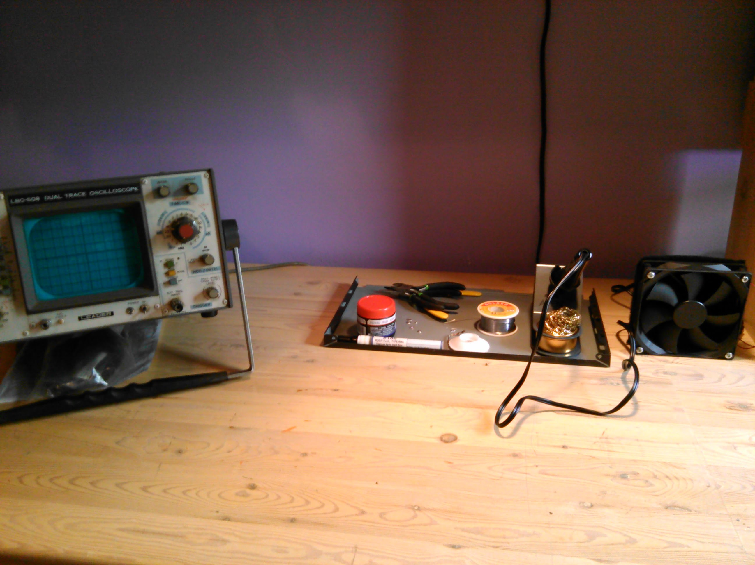
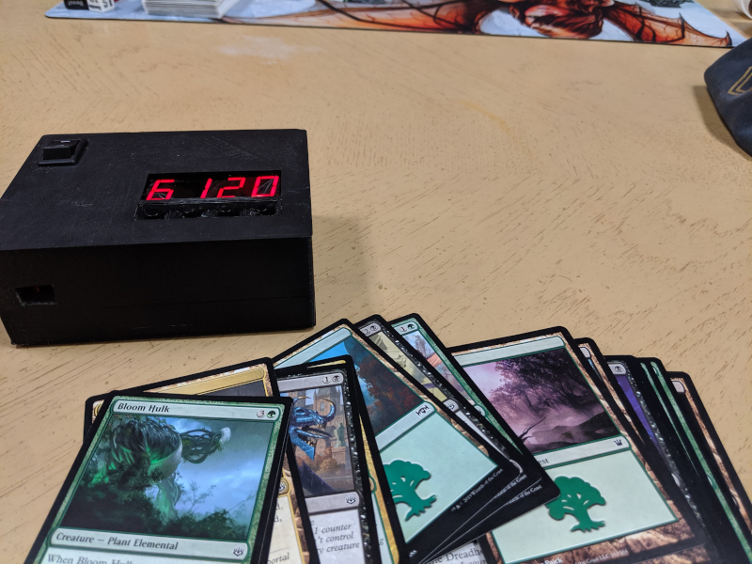
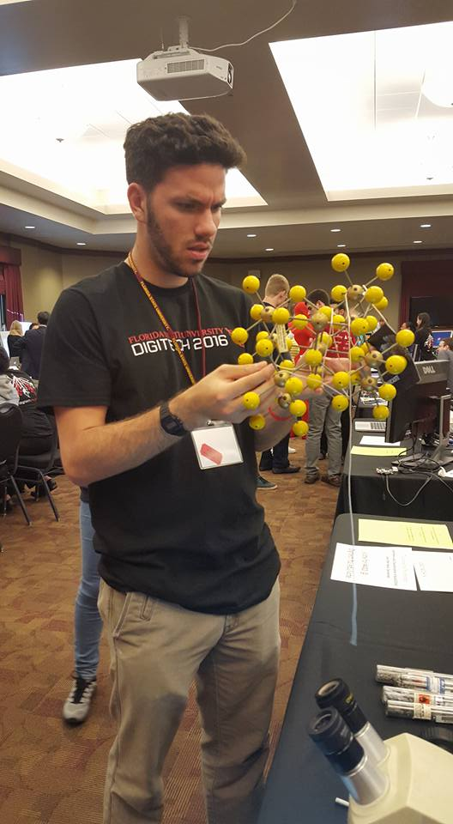
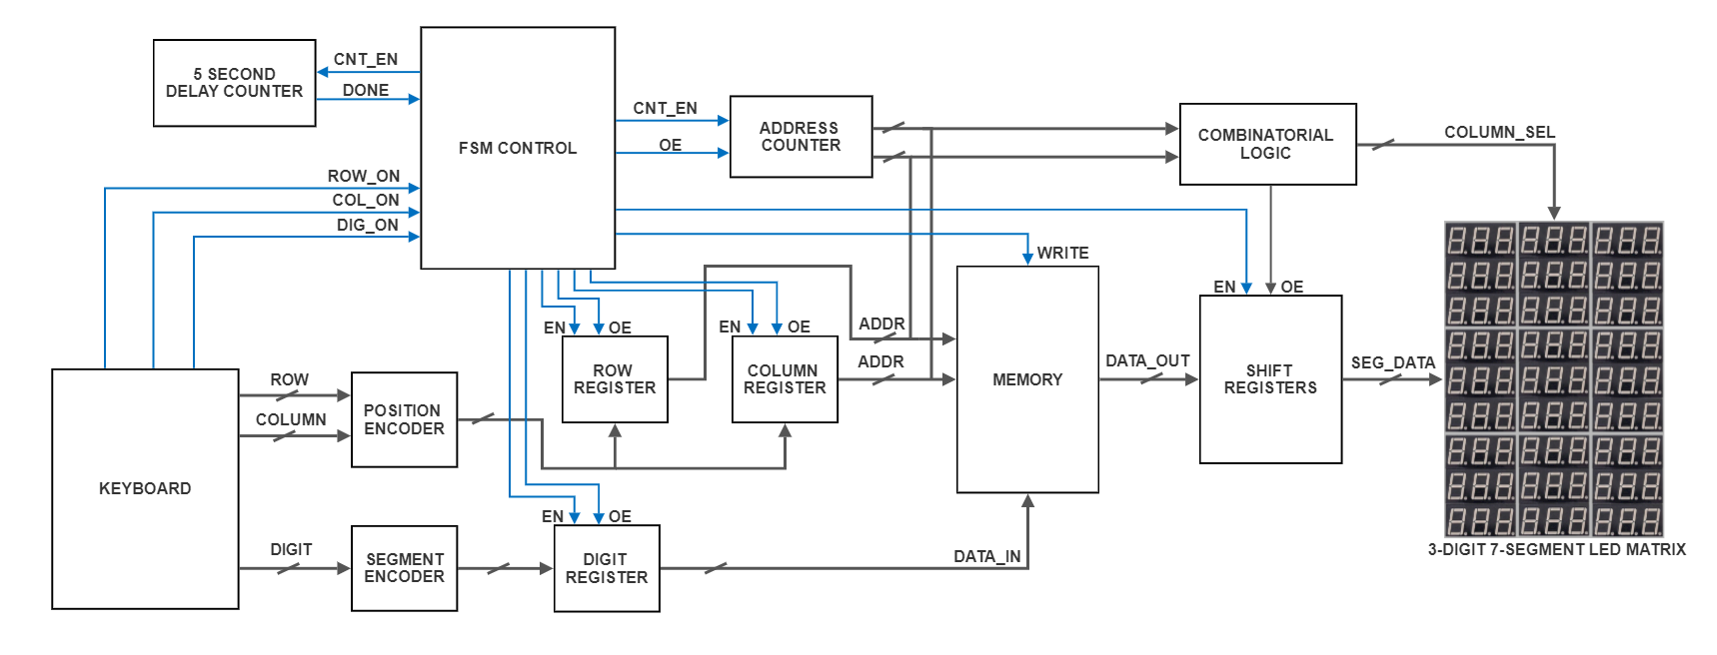
A little about me
American and British
Florida State University (Chemistry and French)
Reorientation to Electrical Engineering
Personal electronic projects
www.justin-silver.com
Passion for speaking French
University of Strasbourg, France
(Electronics)
Summer intern – ICube Fluid Mechanics Laboratory working with lasers, analog circuits, interferometry experiments

Slide 4
…and what about you?
Interest levels
Degrees
Programming languages and skills
Previous projects
Electrical Engineering and digital circuit knowledge
Arduino and FPGA knowledge
Career goals

Slide 5
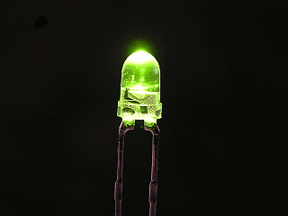
Topic presentation
Let’s blink an LED!
Hardware equivalent of “Hello, World!”
Arduino implementation (C/C++)
FPGA implementation (VHDL)
But like… why??
Spark your interest in electronics and programming
Coding software vs. hardware
Abstraction (facility) vs. complexity (flexibility)
Learn about digital logic

Slide 6
Arduino time…

Slide 7
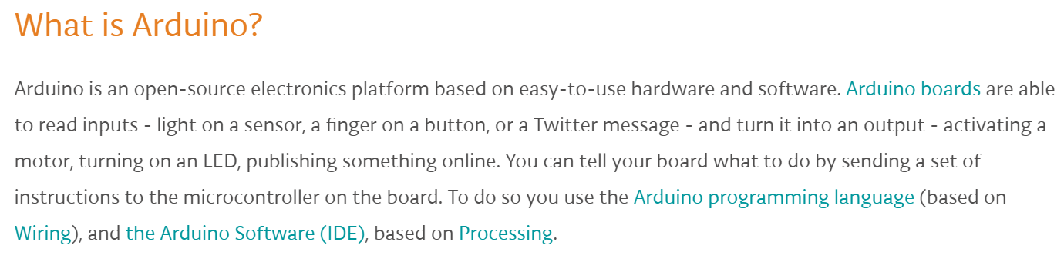
Arduino introduction
From the official Arduino website…
Originally started as a research project by Massimo Banzi, David Cuartielles, Tom Igoe, Gianluca Martino, and David Mellis at the Interaction Design Institute of Ivrea in the early 2000s
The first Arduino board was released in 2005 for students with no previous knowledge of electronics and programming to prototype and create devices
C/C++ programming language
Hobbyist/maker movement

Slide 8

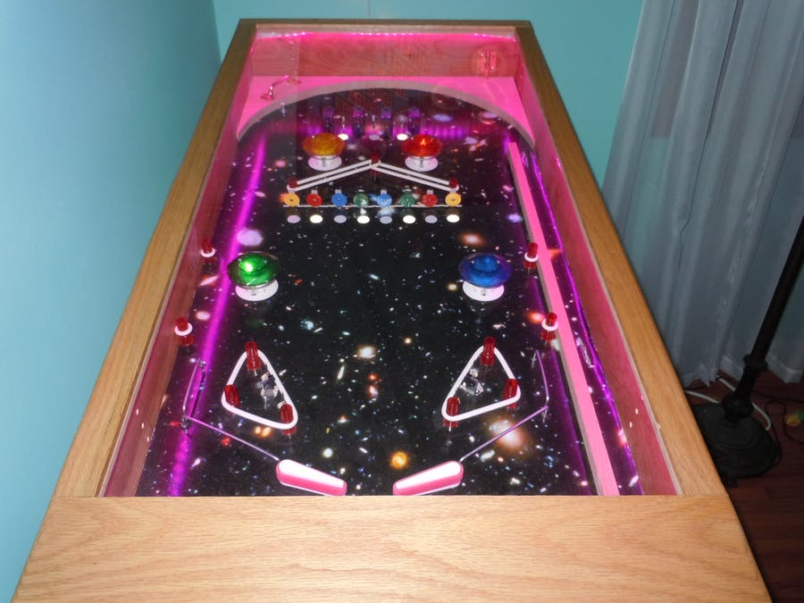
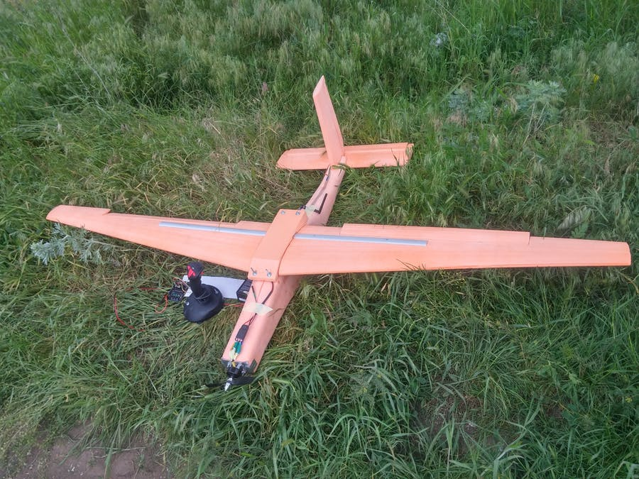
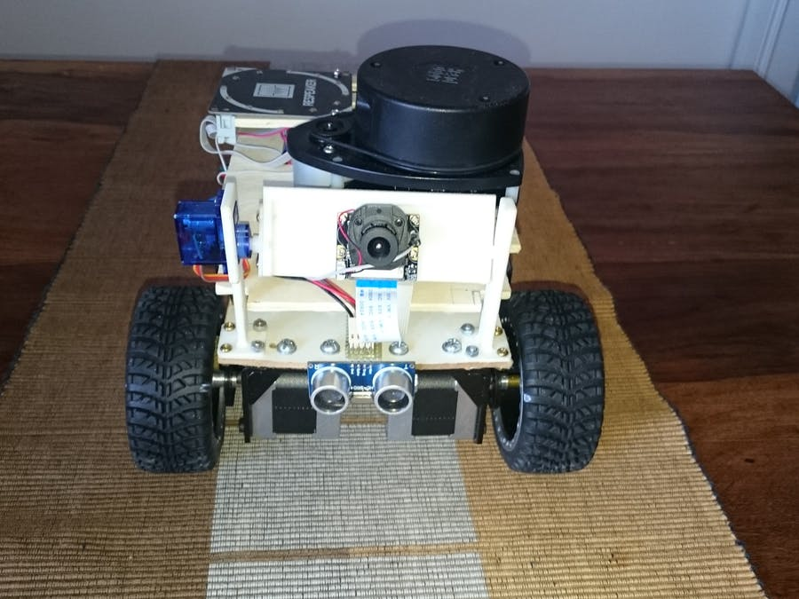
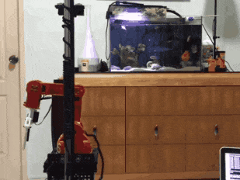
Arduino Controlled Pinball Machine
Punch Activated Arm Flamethrowers (Real Firebending)
UAV Arduino
Gizmo, App and Voice Controlled Robotic Vehicle
Autonomous Home Assistant Robot

Slide 9
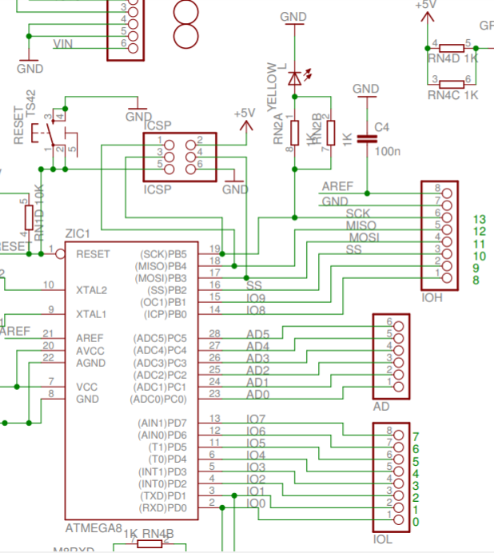
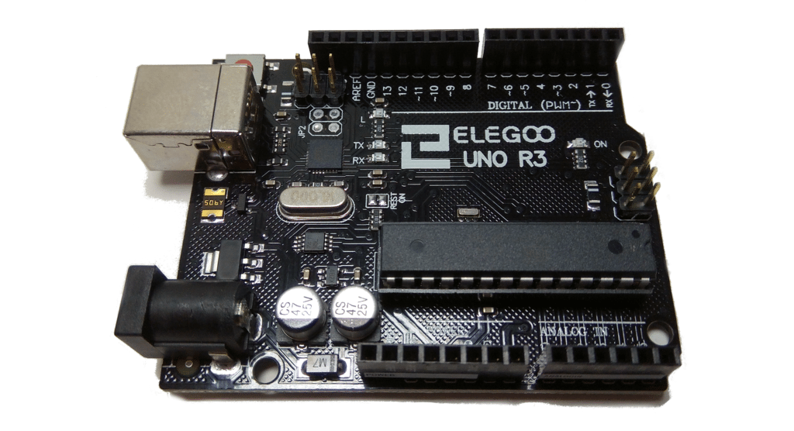
Coding - Arduino

Slide 10
FPGA time…
But before that….

Slide 11
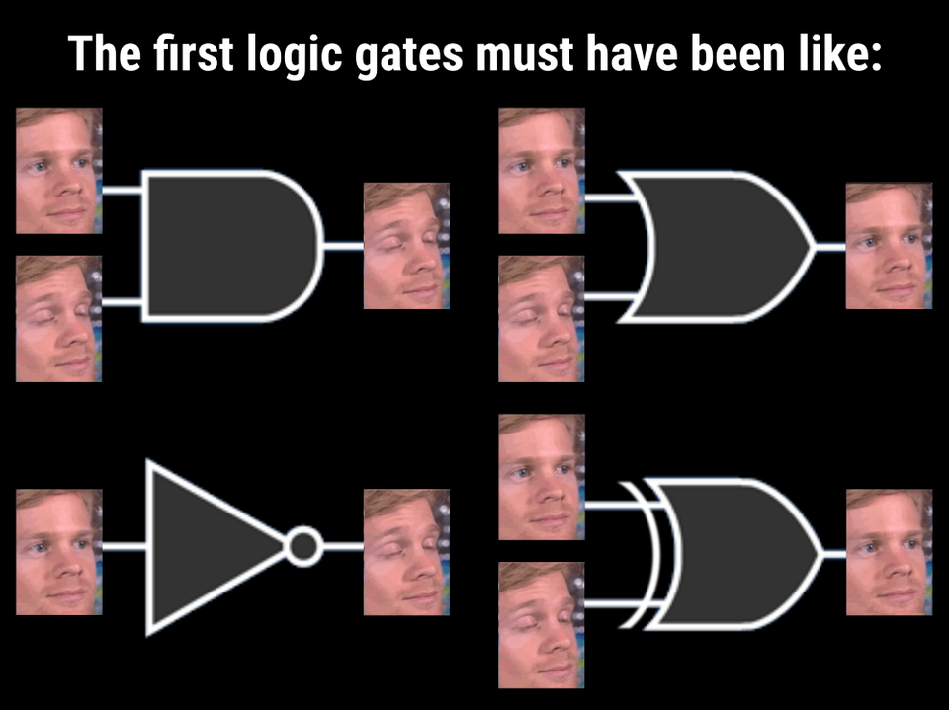
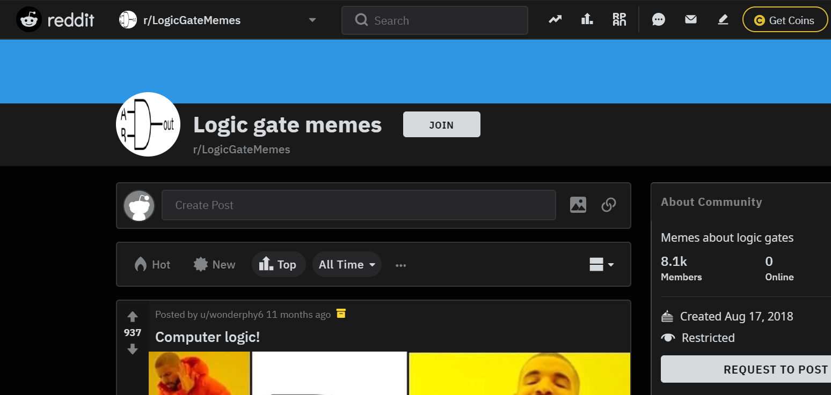
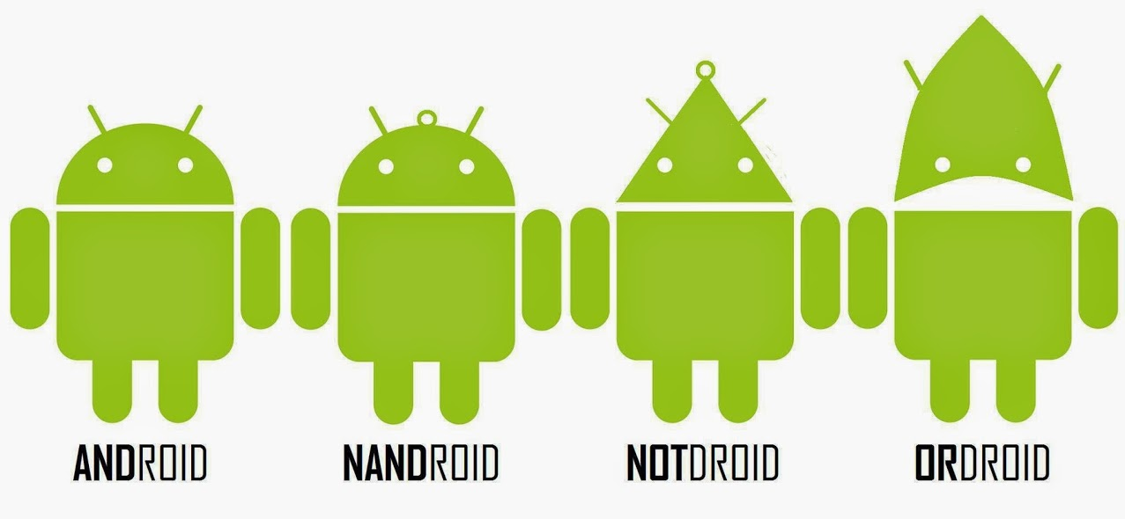
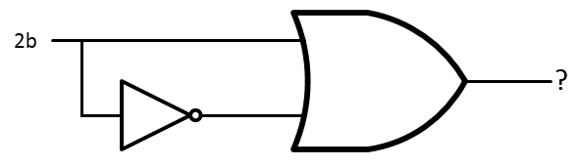
Digital logic principles
Nomen_Heroum (reddit)
eyl327 (reddit)

Slide 12
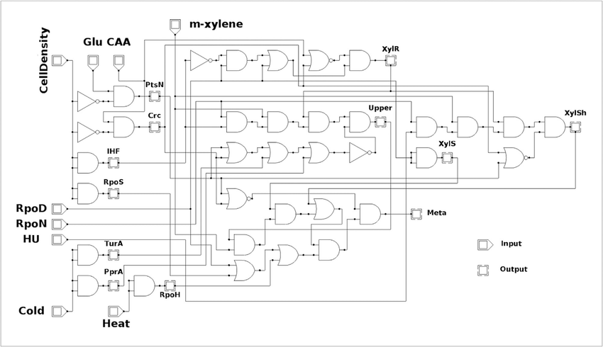
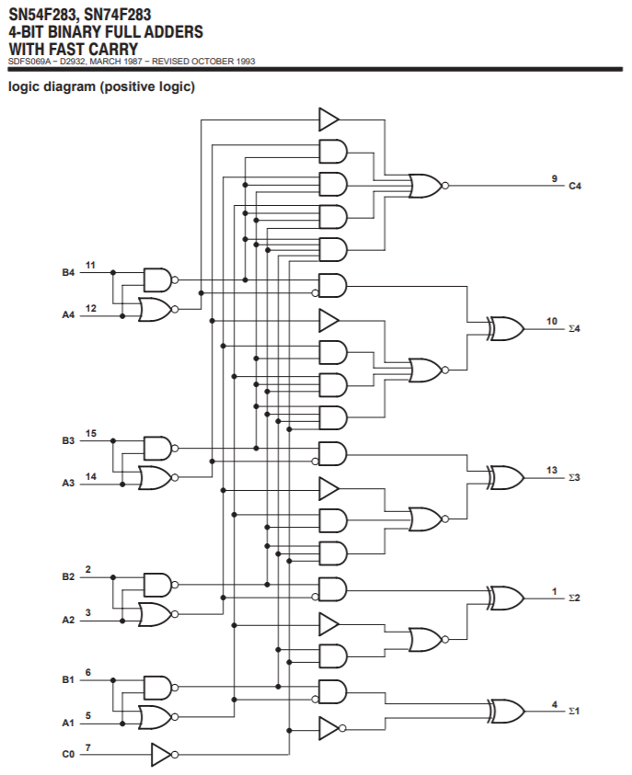
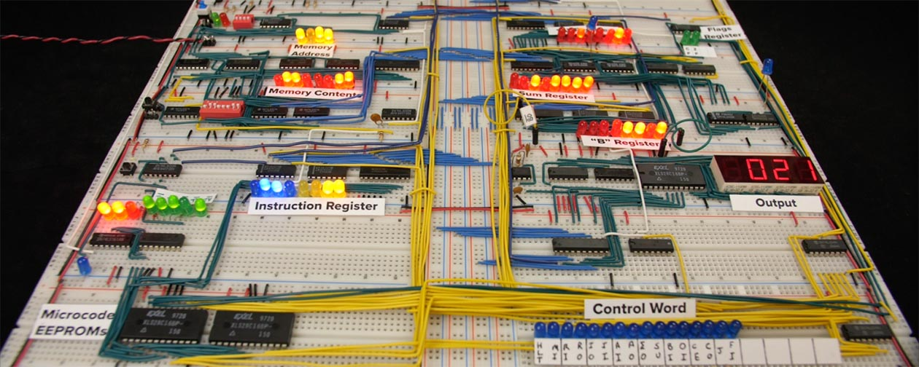
V. de Lorenzo, M. Schmidt, Biological standards for the Knowledge-Based BioEconomy: What is at stake, New Biotechnol. (2017), http://dx.doi.org/10.1016/j.nbt.2017.05.001
Texas Instruments 4-bit full adder (SN54F283)
8-bit breadboard computer made by Ben Eater (www.eater.net)

Slide 13
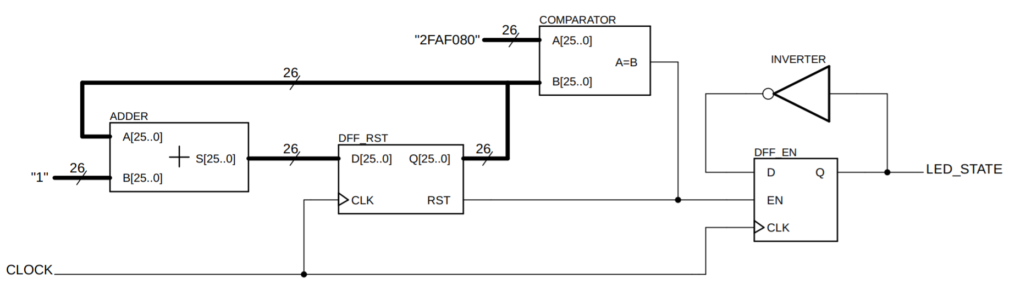
Digital logic – blinking an LED

Slide 14
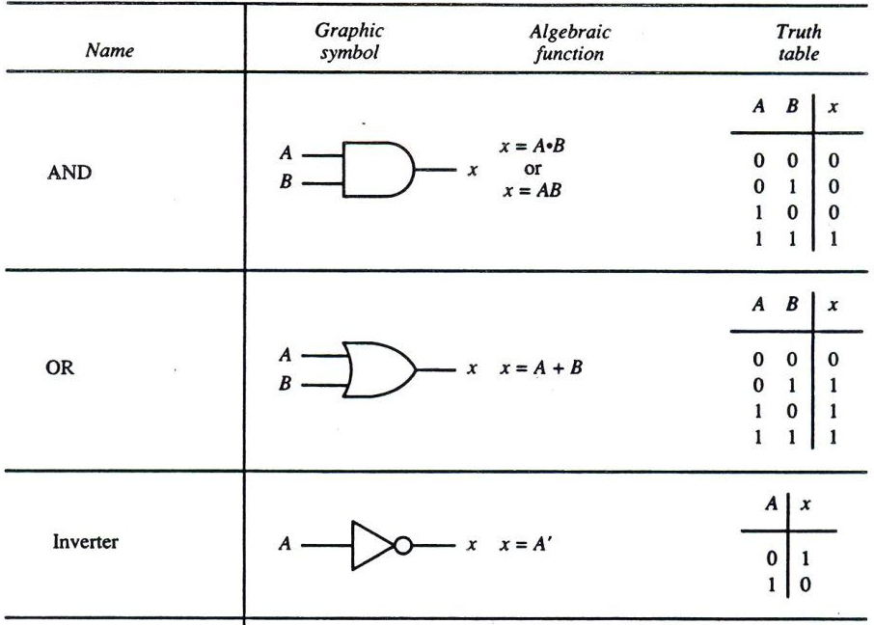
Basic logic gates

Slide 15
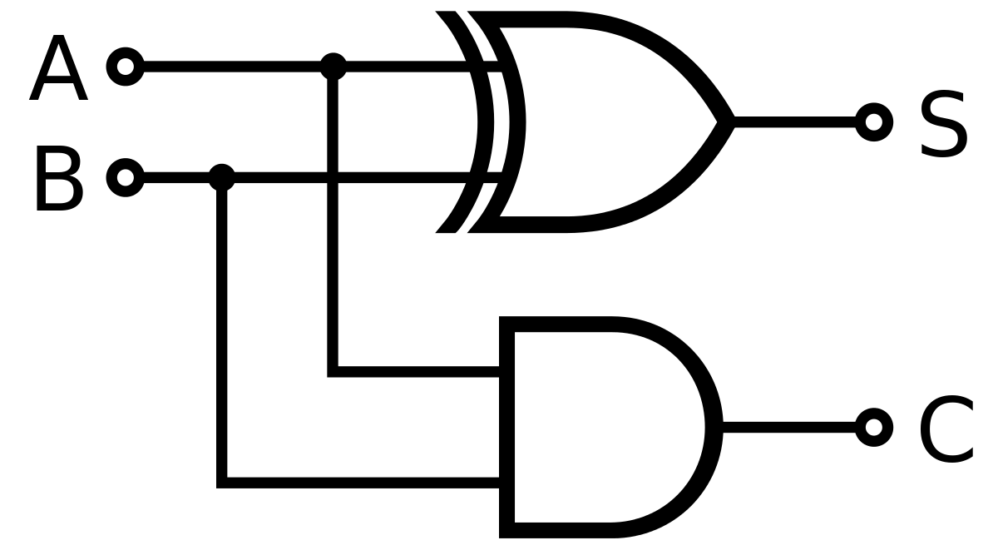
Adders
Truth table
A | B | S | C
0 | 0 | 0 | 0
0 | 1 | 1 | 0
1 | 0 | 1 | 0
1 | 1 | 0 | 1
A[x..0]
Sum[x..0]
Carry out
B[x..0]

Slide 16
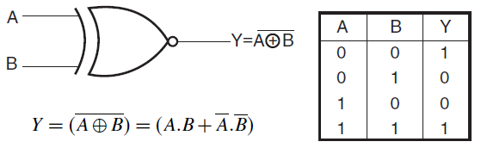
Comparators
A simple comparator is obtained from a single logic gate (XNOR)
A[x..0]
A=B
B[x..0]

Slide 17
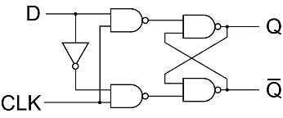
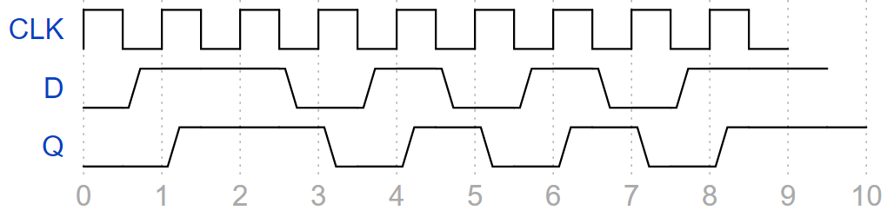
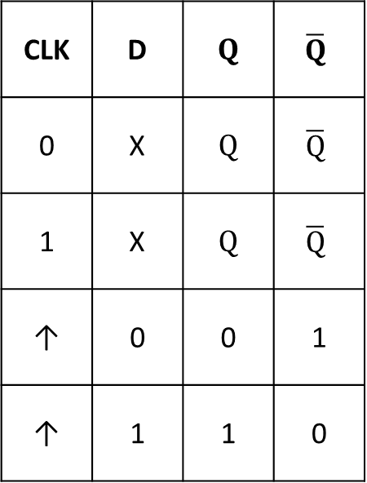
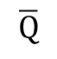

D Flip-Flop (register)
Truth table
CLK | D | $$Q$$ | $$\overline{Q}$$
0 | X | $$Q$$ | $$\overline{Q}$$
1 | X | $$Q$$ | $$\overline{Q}$$
↑ | 0 | 0 | 1
↑ | 1 | 1 | 0
D
$$Q$$
CLK
$$\overline{Q}$$
Chronogram (timing diagram)

Slide 18

Taking another look…
0
1
0
2
3
1
2FAF081
0
1
2
1
2FAF080
0
1
0
0
1
50 million clock cycles later (1 second)….

Slide 19
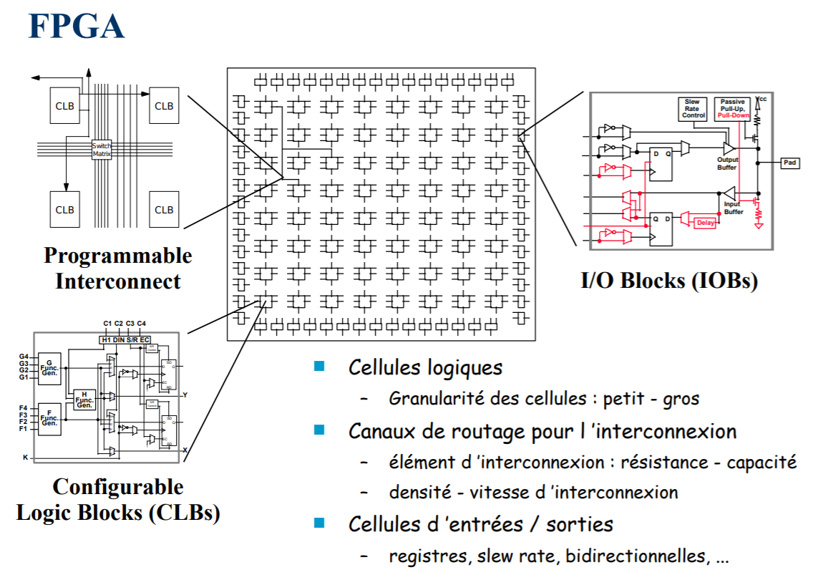
Introduction – FPGA and VHDL
FPGA
Field Programmable Gate Array
Predecessors: PLD, CPLD
Synthesis of any digital logic hardware, completely programmable
Parallel architecture
Coded using VHDL, Verilog, schematic entry
FPGA ≠ microcontroller*
VHDL
VHSIC-HDL, Very High Speed Integrated Circuit Hardware Description Language
Behavioral vs. structural approach
Parallel code execution
Generic internal structure of an FPGA
*it could be programmed to be though… https://www.fpga4student.com/2016/12/a-complete-8-bit-microcontroller-in-vhdl.html

Slide 20
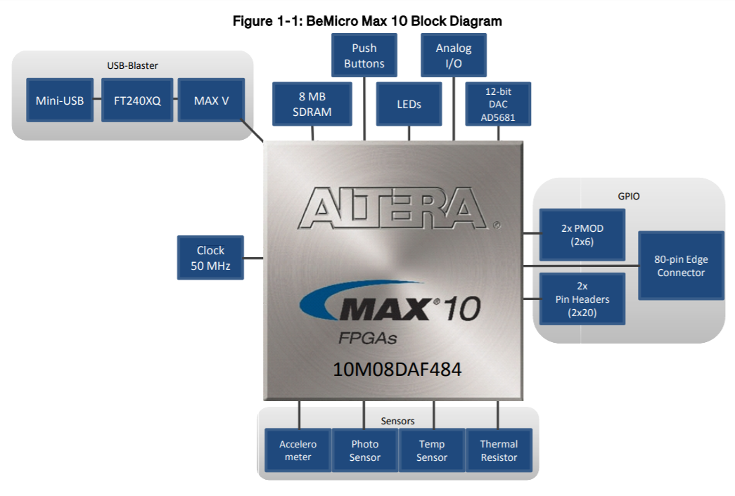
Coding - FPGA

Slide 21
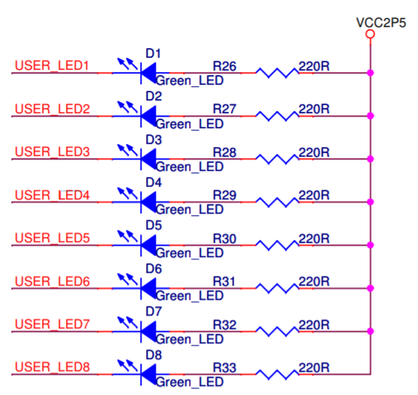
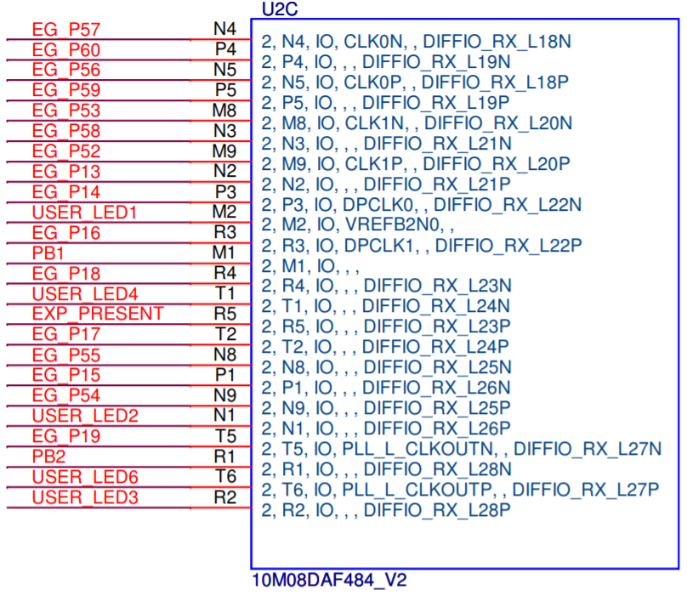
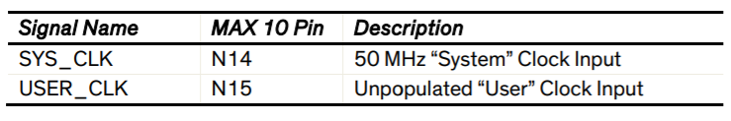
Pin assignment

Slide 22
Improvements?
Adding button inputs – each button gives a different delay length
Connecting a thermistor and as the temperature increases the frequency of blinking follows
Connecting a DC buzzer to the ON/OFF signal – now you have a makeshift metronome!
Our structural FPGA code is not flexible: changing the delay time is not easy
Speed, performance, compile time optimization within Quartus II

Slide 23
Annex, links, useful stuff
Buying an Elegoo Arduino Starter Kit
Check out more awesome Arduino projects
Instructions for installing the Arduino software
Arduino tutorials
Buying a BeMicro Max 10 FPGA dev kit
Installing Quartus II (pay attention to the version)
Basic Quartus II tutorial (Eric M. Schwartz - University of Florida)
Intel YouTube page
VHDL basics
Tinkercad - Simulating online digital circuits (breadboard)
Ben Eater (YouTube)
EEVblog (YouTube)
GreatScott (YouTube)
Presentation slides and source code for this talk will be available on my GitHub

Slide 24
Thanks for coming! Huge thanks to Monthly Mini Hacks, The Surrey Reproducibility Society, and Danielle Kurtin
Questions, comments, concerns?
Email: justinrsilver@gmail.com

